Slide 1

Capstone Project

Slide 2



Personal BACKGROUND
(Name, Past Experience, Qualification, Career Summary)
Name : Balasaranya S
Past Experience : Fresher
Qualification : B.Tech Information Technology
Career Summary :Enthusiastic and motivated Associate Software Engineer at Ascendion, developing scalable web applications using Java and Spring Boot. Expertise in microservices architecture, database management, and leading agile teams. Recently graduated, I bring fresh perspectives and a passion for developing efficient, scalable software solutions. I am eager to contribute to innovative projects and grow my expertise within a dynamic and forward-thinking team.
www.collaberadigital.com

Slide 3


Key Takeaways/Learnings from the Program (HTD)
Hands-on Experience: Gained practical experience in core technologies such as Java, MySQL, Spring Boot, AWS, and microservices architecture.
Problem-Solving Skills: Developed the ability to approach complex problems with structured and efficient solutions.
Project Implementation: Learned how to apply theoretical knowledge to real-world projects, understanding the entire software development lifecycle.
Code Quality: Adopted best practices in coding, including writing clean, maintainable code and following coding standards.
Agile Methodologies: Gained familiarity with agile frameworks and how to work effectively within a sprint-based development environment.
Version Control: Learned to use version control systems (like Git) for collaborative coding and managing project versions.

Slide 4

Problem Statement of the Capstone Project.
The Air Transport System (ATS) Capstone Project requires developing a comprehensive software solution for managing various aspects of air transportation, specifically tailored for administrators.
The application must be built using Spring Boot and microservices architecture, deployed on AWS, and should enable administrators to manage and view details of airports, planes, and passenger bookings.
Key functionalities include secure login with account lockout after multiple failed attempts, the ability to view and manage airport and plane details with auto-generated codes, and comprehensive booking management.
The project also emphasizes the use of industry best practices such as proper coding standards, modular design, robust exception handling, and effective validation across different layers of the application.
Additionally, the system must be integrated with a service registry, perform client-side load balancing, and ensure seamless operation through a dynamic API gateway. The backend will use MySQL, with Spring Data JPA and Hibernate for ORM, and all REST APIs are to be thoroughly tested using Postman.
This project demands a solid grasp of microservices architecture, cloud deployment, and software development best practices to deliver a scalable, efficient, and maintainable system.

Slide 5
Key Technologies Used To Build the Project.
Spring Boot: A framework for building production-ready applications quickly. It was used to develop the microservices for the Air Transport System (ATS), providing features like dependency injection.
Spring Cloud: A set of tools for managing distributed systems and microservices. It was used for service discovery, configuration management, and API gateway in conjunction with Eureka and Feign Client.
Spring Data JPA: A data access framework that provides repository support for various databases. It was used to interact with the MySQL database, allowing the creation of repositories for CRUD operations.
MySQL: A relational database management system. MySQL Workbench was used to design and manage the database schema, including tables for planes, airports, bookings, etc.
Eureka Server: A service registry provided by Netflix OSS. It was used for service discovery, allowing microservices to register themselves and discover other services.
Feign Client: A declarative HTTP client that integrates with Spring Cloud. It was used to communicate between microservices, such as between the Login microservice and Admin microservice.
Postman: An API testing tool used to test the endpoints of the microservices, ensuring that they function as expected.
IntelliJ IDEA: The integrated development environment (IDE) used for coding, debugging, and managing the project.
Maven: A build automation tool used for managing project dependencies and building the application

Slide 6
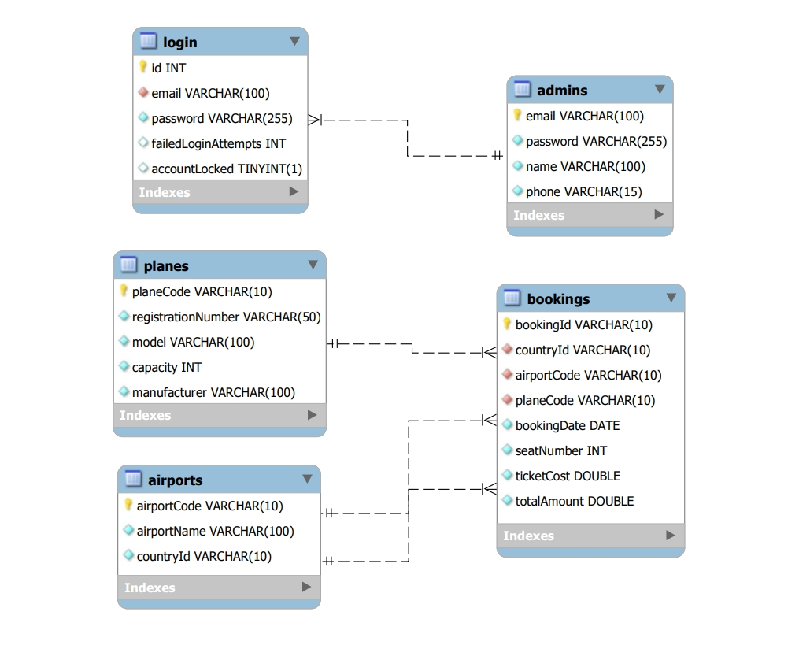
Database Design

Slide 7

Project Highlights
Implemented auto-generation of unique codes for planes and airports (e.g., "P0001", "A0001") to ensure data integrity.
Secure login feature with email and password validation, along with account lockout functionality after multiple failed login attempts.
Integrated various microservices using Eureka Server for easy management and scalability.
Deployed the system on AWS, ensuring high availability and performance.

Slide 8
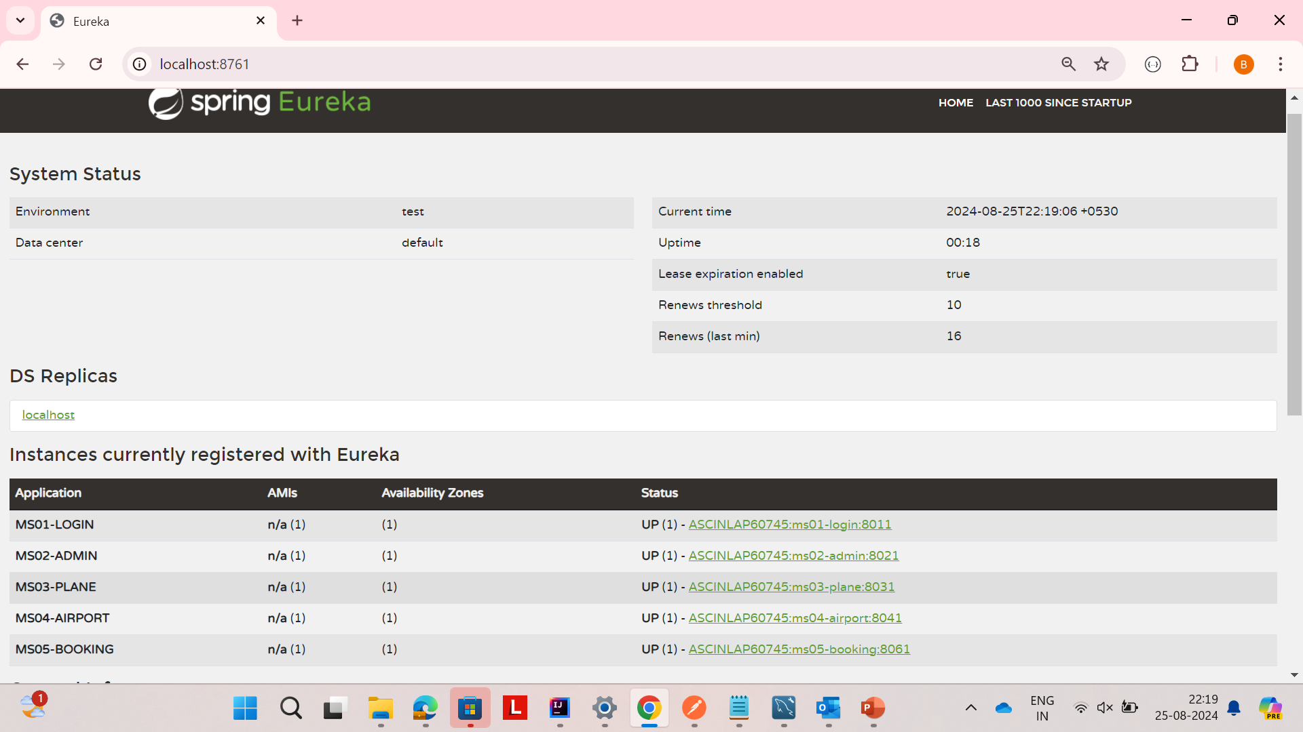
Eureka Dashbord with all Microservices Registered

Slide 9
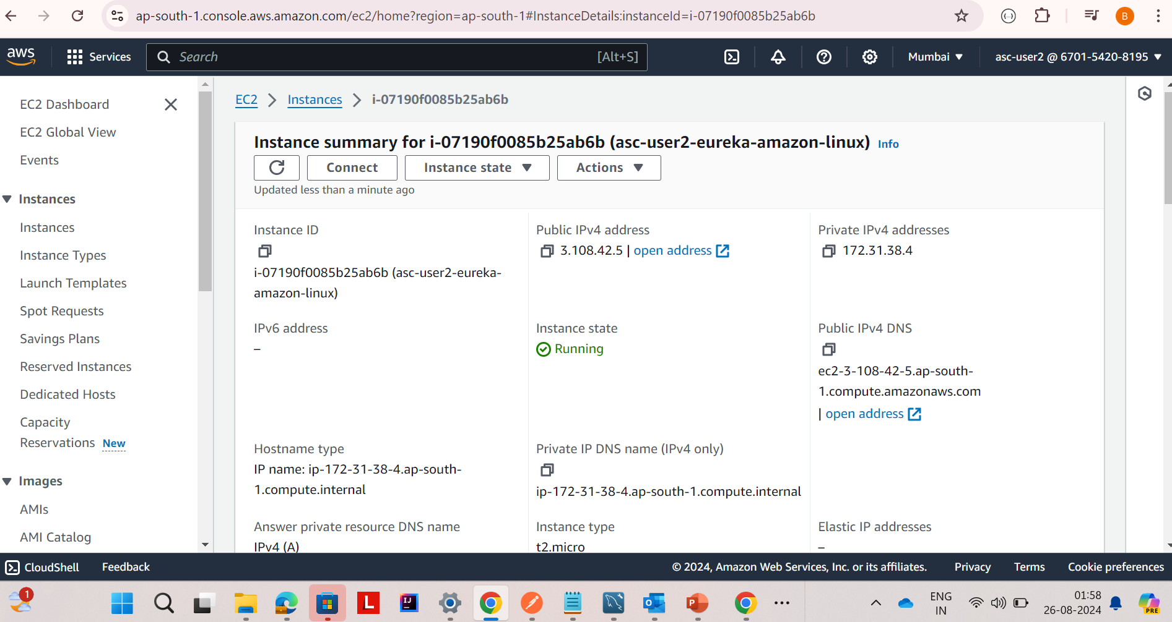
Instance Deployed In AWS

Slide 10
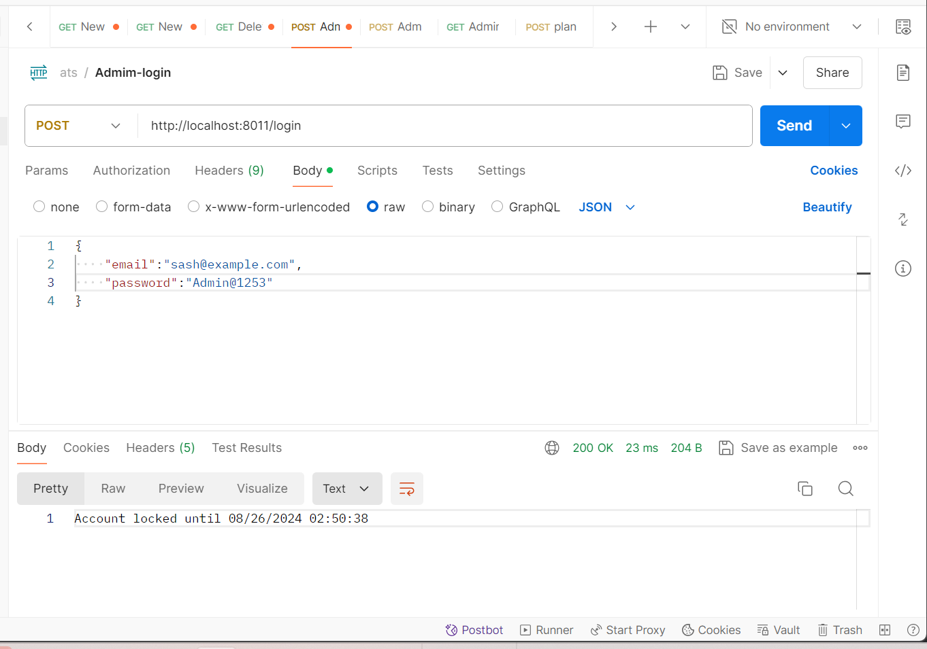
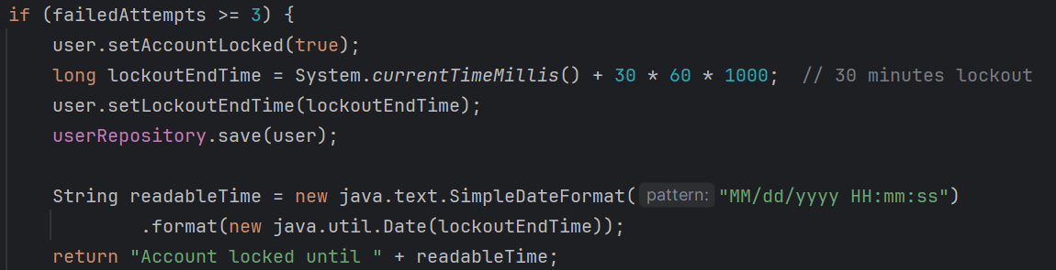
Feature to show Locked Until Time when the Account is locked

Slide 11
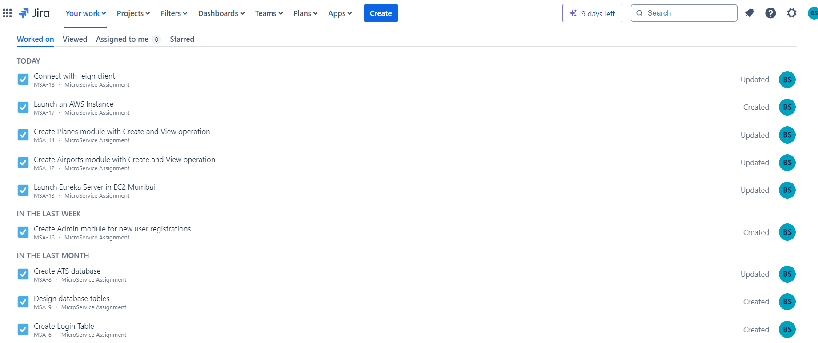
Sprint Completion Overview

Slide 12
Conclusion
This project demonstrates the effective use of microservices architecture to build a scalable and modular Air Transport System. By leveraging key technologies such as Spring Boot, MySQL, and Eureka Server, we were able to create independently deployable services that communicate seamlessly. The integration of AWS for deployment further ensures that the system is robust, secure, and ready for real-world applications.
The systematic approach, from the design of the database schema to the implementation of microservices, allowed for a clear separation of concerns and easy management of each service. The use of Feign Clients for inter-service communication, and the automated generation of unique codes for planes and airports, showcases the attention to detail and adherence to best practices.

Slide 13
Thank You

